Slide 1
XFA : Faster Signature Matching With Extended Automata
Author: Randy Smith, Cristian Estan and Somesh Jha
Publisher: IEEE Symposium on Security and Privacy 2008
Presenter: Yu-Hao, Tseng
Date: 2014/01/15

Slide 2
Outline
Introduction
Technical overview
Build XFAs from Regex
Experimental Results

Slide 3
Introduction
In this paper their primary goal is to improve the time and space efficiency of signature matching in network intrusion detection systems (NIDS).
To achieve their goal they introduce extended finite automata (XFAs) which augment traditional FSAs with a finite scratch memory used to remember various types of information relevant to the progress of signature matching.

Slide 4
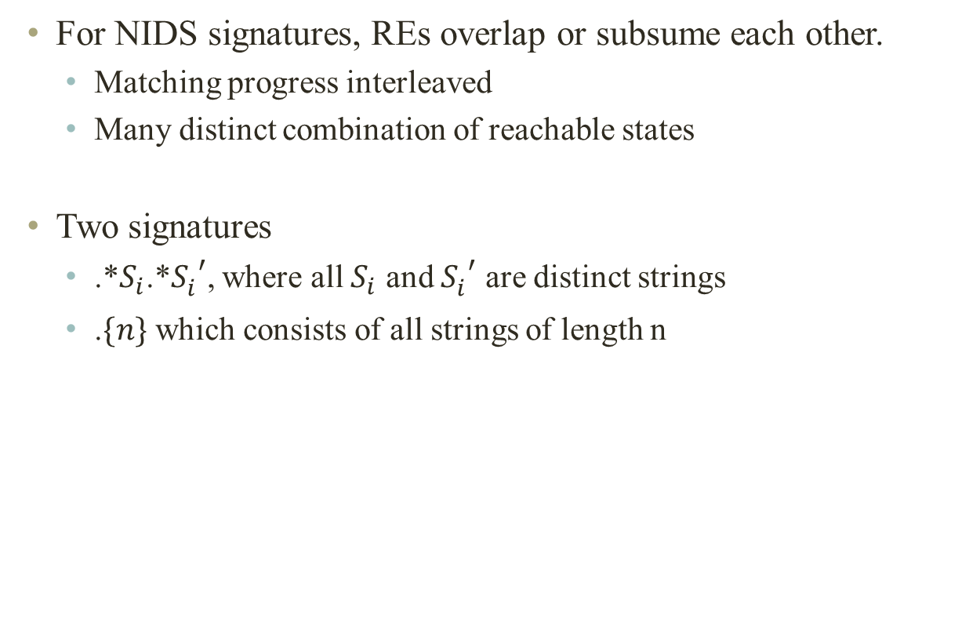
Technical overview
For NIDS signatures, REs overlap or subsume each other.
  Matching progress interleaved
  Many distinct combination of reachable states
Two signatures
  .*$S_{i}$.*${S_{i}^{}}_{}^{′}$, where all $S_{i}$ and ${S_{i}^{}}_{}^{′}$ are distinct strings
  .$\{n\}$ which consists of all strings of length n

Slide 5
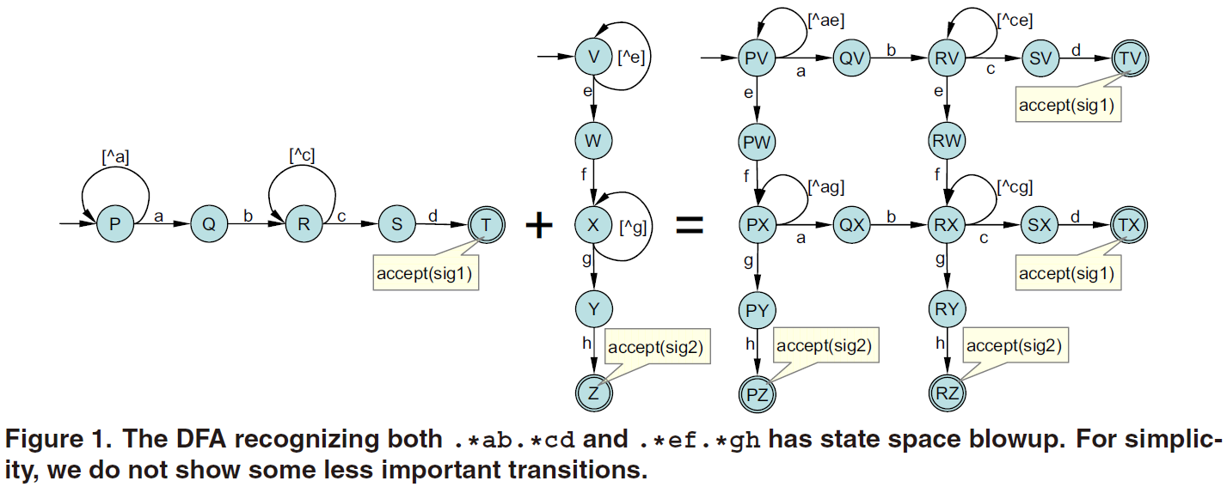

Technical overview (Cont.)
.*$S_{i}$.*${S_{i}^{}}_{}^{′}$, where all $S_{i}$ and ${S_{i}^{}}_{}^{′}$ are distinct strings

Slide 6
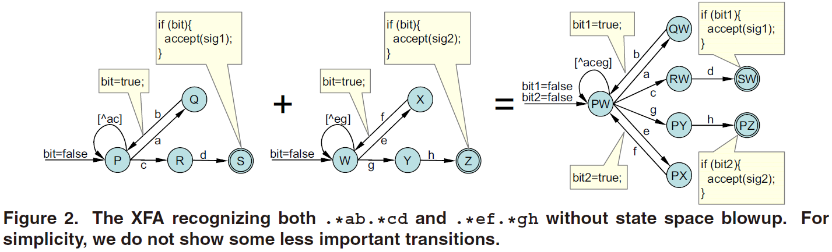

Technical overview (Cont.)
.*$S_{i}$.*${S_{i}^{}}_{}^{′}$, where all $S_{i}$ and ${S_{i}^{}}_{}^{′}$ are distinct strings
  use a single bit of scratch memory

Slide 7
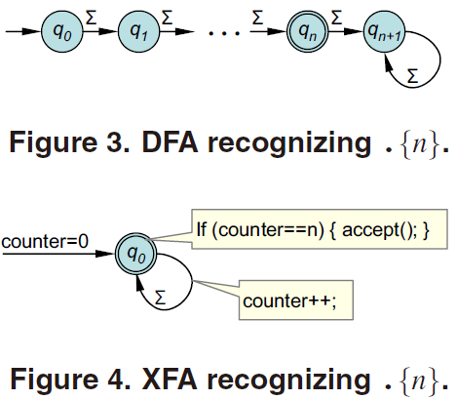

Technical overview (Cont.)
  .$\{n\}$ which consists of all strings of length n
    use a counter

Slide 8
Technical overview (Cont.)
  XFA = DFAs+ auxiliary variables􀂄
    Changes shape of automata
    Tames state space explosion

Slide 9
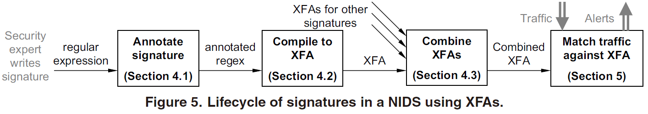
Build XFAs from Regex
Annotating regular expressions
Compiling to an XFA
  From parse trees to NXFAs
  From NXFAs to XFAs
    ε –elimination
    determinizing transitions
    data determinization
  Finding efficient implementations

Slide 10
Build XFAs from Regex (Cont.)
Annotate Signature
  New operators change parse tree and add domain values 􀂄
    Parallel concatenation ( # ) adds a bit􀂆
    Breaks up RE into string-like components
    Set a bit when the left operand accepts
    Test the bit when the right operand accepts
  ex: .*ab.*cd => .*ab#.*cd

Slide 11
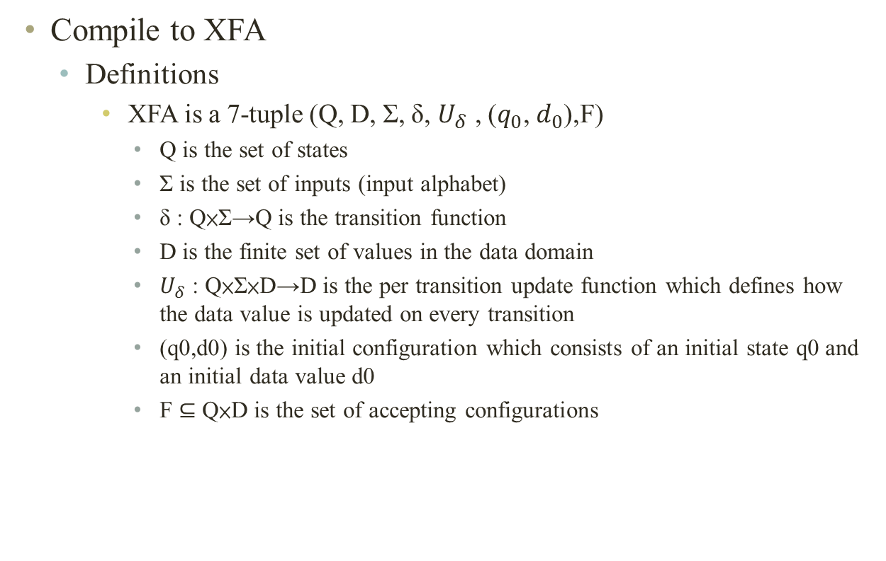
Build XFAs from Regex (Cont.)
Compile to XFA
  Definitions
    XFA is a 7-tuple (Q, D, Σ, δ, $U_{δ}$ , ($q_{0}$, $d_{0}$),F)
      Q is the set of states
      Σ is the set of inputs (input alphabet)
      δ : Q×Σ→Q is the transition function
      D is the finite set of values in the data domain
      $U_{δ}$ : Q×Σ×D→D is the per transition update function which defines how the data value is updated on every transition
      (q0,d0) is the initial configuration which consists of an initial state q0 and an initial data value d0
      F ⊆ Q×D is the set of accepting configurations

Slide 12
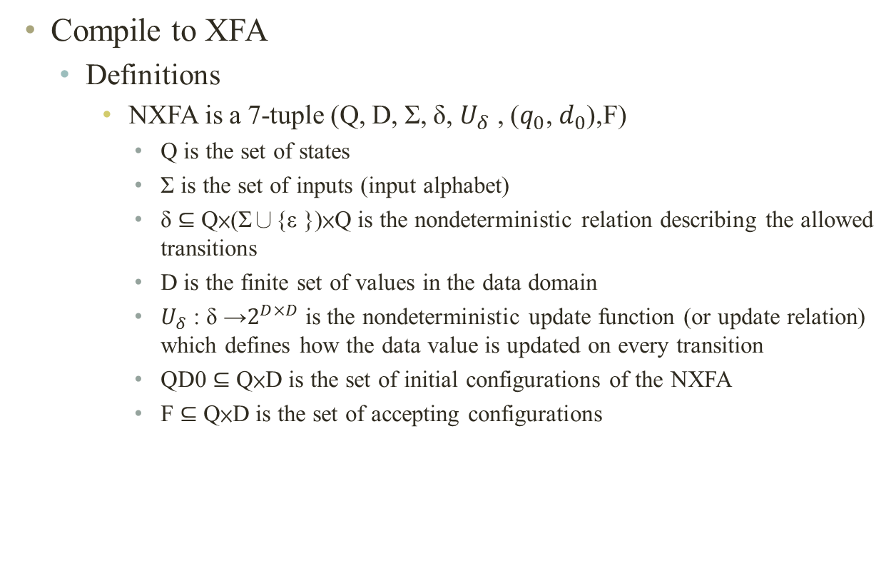
Build XFAs from Regex (Cont.)
Compile to XFA
  Definitions
    NXFA is a 7-tuple (Q, D, Σ, δ, $U_{δ}$ , ($q_{0}$, $d_{0}$),F)
      Q is the set of states
      Σ is the set of inputs (input alphabet)
      δ ⊆ Q×(Σ∪{ε })×Q is the nondeterministic relation describing the allowed transitions
      D is the finite set of values in the data domain
      $U_{δ}$ : δ →$2^{D×D}$ is the nondeterministic update function (or update relation) which defines how the data value is updated on every transition
      QD0 ⊆ Q×D is the set of initial configurations of the NXFA
      F ⊆ Q×D is the set of accepting configurations

Slide 13
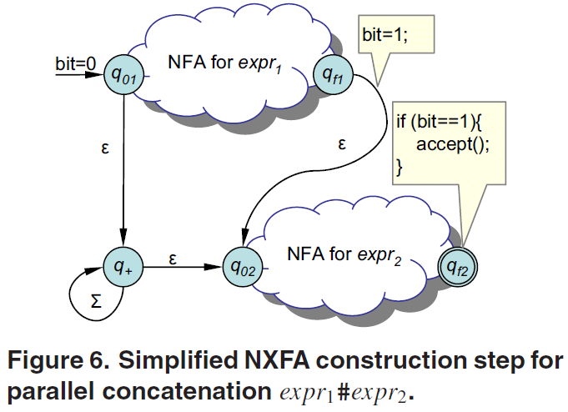
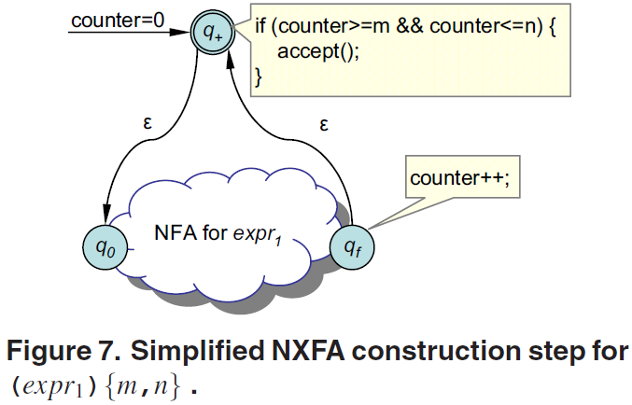
Build XFAs from Regex (Cont.)
Compile to XFA
  From parse trees to NXFAs

Slide 14
Build XFAs from Regex (Cont.)
Compile to XFA
  From parse trees to NXFAs
Ex : .*ab[^a]{1} => .*ab#[^a]{1}
bit = 0
cnt = 0
∑
＃
0
a
‧
{1}
ε
1
∑
3
‧
ｂ
[^a]
b
ε
2
＊
ａ
ε
bit = 1
4
cnt++
[^a]
∑
if (bit == 1 && cnt = 1) accept();

Slide 15
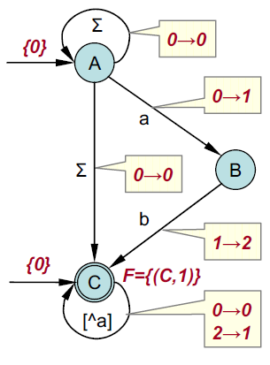

Build XFAs from Regex (Cont.)
Compile to XFA
  From parse trees to NXFAs
Ex : .*ab[^a]{1} => .*ab#[^a]{1}
bit = 0
cnt = 0
∑
0
a
ε
1
∑
3
$$ε$$
b
ε
2
ε
bit = 1
4
cnt++
[^a]
if (bit == 1 && cnt = 1) accept();

Slide 16
Build XFAs from Regex (Cont.)
Compile to XFA
  Alg. 1 : ε -elimination for NXFAs
$$ε$$

Slide 17
Build XFAs from Regex (Cont.)
Compile to XFA
  Alg. 1 : ε -elimination for NXFAs
$$ε$$

Slide 18
Build XFAs from Regex (Cont.)
Compile to XFA
  Alg. 1 : ε -elimination for NXFAs
$$ε$$

Slide 19
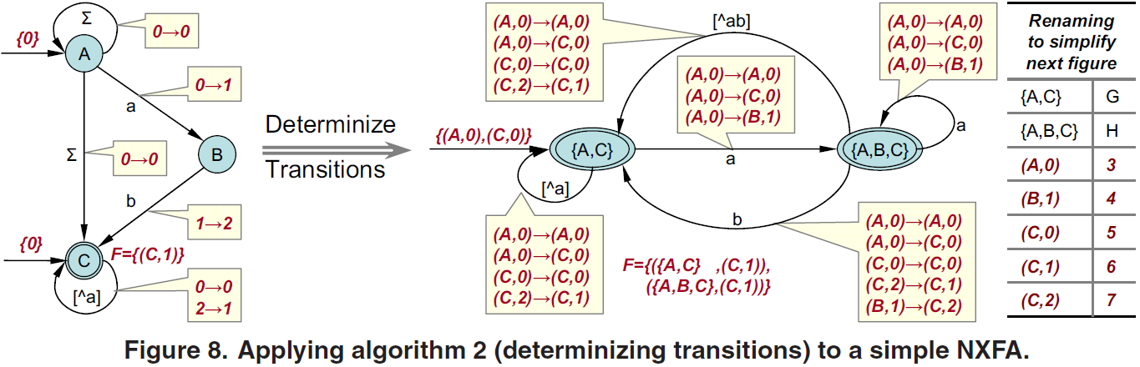
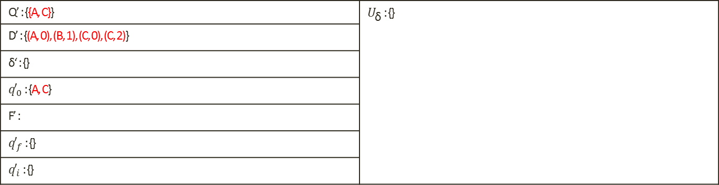
Build XFAs from Regex (Cont.)
Compile to XFA
  Alg. 2 : determinizing transitions for NXFAs
Q’ : {{A, C}} | $U_{\text{δ}}$ : {}
D’ : {(A, 0), (B, 1), (C, 0), (C, 2)}
δ‘ : {}
${q′}_{0}$ : {A, C}
F’ :
${q′}_{f}$ : {}
${q′}_{i}$ : {}

Slide 20
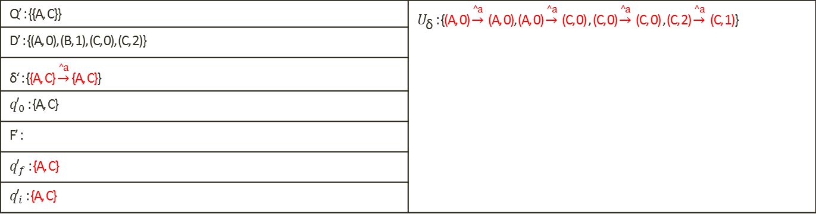
Build XFAs from Regex (Cont.)
Compile to XFA
  Alg. 2 : determinizing transitions for NXFAs
Q’ : {{A, C}} | $U_{\text{δ}}$ : {(A, 0) $\underset{→}{^a}$ (A, 0), (A, 0) $\underset{→}{^a}$ (C, 0) , (C, 0) $\underset{→}{^a}$ (C, 0) , (C, 2) $\underset{→}{^a}$ (C, 1)}
D’ : {(A, 0), (B, 1), (C, 0), (C, 2)}
δ‘ : {{A, C} $\underset{→}{^a}$ {A, C}}
${q′}_{0}$ : {A, C}
F’ :
${q′}_{f}$ : {A, C}
${q′}_{i}$ : {A, C}

Slide 21
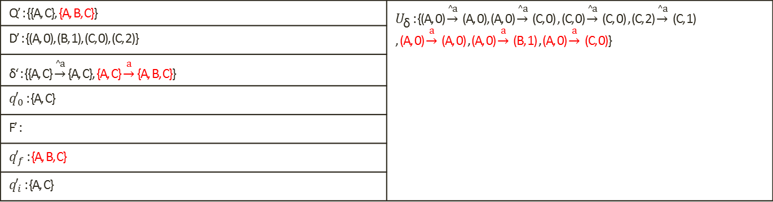
Build XFAs from Regex (Cont.)
Compile to XFA
  Alg. 2 : determinizing transitions for NXFAs
Q’ : {{A, C}, {A, B, C}} | $U_{\text{δ}}$ : {(A, 0) $\underset{→}{^a}$ (A, 0), (A, 0) $\underset{→}{^a}$ (C, 0) , (C, 0) $\underset{→}{^a}$ (C, 0) , (C, 2) $\underset{→}{^a}$ (C, 1) , (A, 0) $\underset{→}{a}$ (A, 0) , (A, 0) $\underset{→}{a}$ (B, 1) , (A, 0) $\underset{→}{a}$ (C, 0)}
D’ : {(A, 0), (B, 1), (C, 0), (C, 2)}
δ‘ : {{A, C} $\underset{→}{^a}$ {A, C}, {A, C} $\underset{→}{a}$ {A, B, C}}
${q′}_{0}$ : {A, C}
F’ :
${q′}_{f}$ : {A, B, C}
${q′}_{i}$ : {A, C}

Slide 22
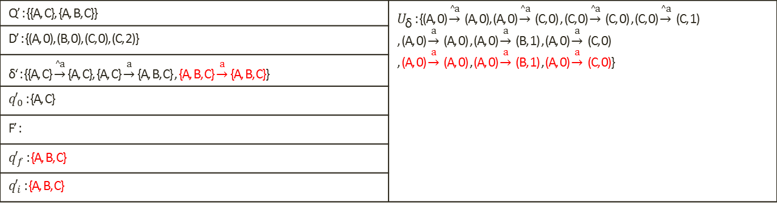
Build XFAs from Regex (Cont.)
Compile to XFA
  Alg. 2 : determinizing transitions for NXFAs
Q’ : {{A, C}, {A, B, C}} | $U_{\text{δ}}$ : {(A, 0) $\underset{→}{^a}$ (A, 0), (A, 0) $\underset{→}{^a}$ (C, 0) , (C, 0) $\underset{→}{^a}$ (C, 0) , (C, 0) $\underset{→}{^a}$ (C, 1) , (A, 0) $\underset{→}{a}$ (A, 0) , (A, 0) $\underset{→}{a}$ (B, 1) , (A, 0) $\underset{→}{a}$ (C, 0) , (A, 0) $\underset{→}{a}$ (A, 0) , (A, 0) $\underset{→}{a}$ (B, 1) , (A, 0) $\underset{→}{a}$ (C, 0)}
D’ : {(A, 0), (B, 0), (C, 0), (C, 2)}
δ‘ : {{A, C} $\underset{→}{^a}$ {A, C}, {A, C} $\underset{→}{a}$ {A, B, C} , {A, B, C} $\underset{→}{a}$ {A, B, C}}
${q′}_{0}$ : {A, C}
F’ :
${q′}_{f}$ : {A, B, C}
${q′}_{i}$ : {A, B, C}

Slide 23
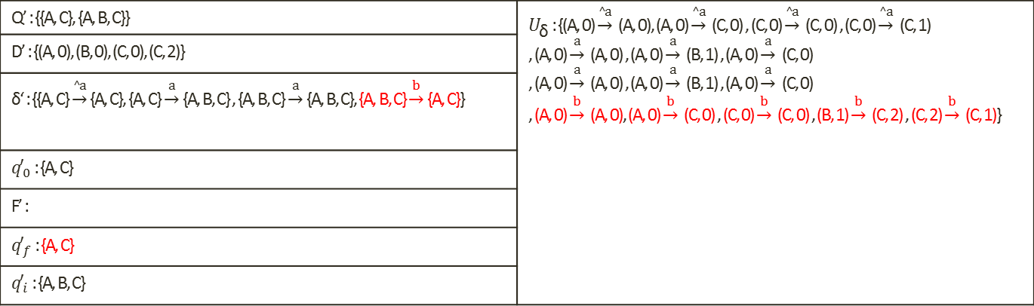
Build XFAs from Regex (Cont.)
Compile to XFA
  Alg. 2 : determinizing transitions for NXFAs
Q’ : {{A, C}, {A, B, C}} | $U_{\text{δ}}$ : {(A, 0) $\underset{→}{^a}$ (A, 0), (A, 0) $\underset{→}{^a}$ (C, 0) , (C, 0) $\underset{→}{^a}$ (C, 0) , (C, 0) $\underset{→}{^a}$ (C, 1) , (A, 0) $\underset{→}{a}$ (A, 0) , (A, 0) $\underset{→}{a}$ (B, 1) , (A, 0) $\underset{→}{a}$ (C, 0) , (A, 0) $\underset{→}{a}$ (A, 0) , (A, 0) $\underset{→}{a}$ (B, 1) , (A, 0) $\underset{→}{a}$ (C, 0) , (A, 0) $\underset{→}{b}$ (A, 0), (A, 0) $\underset{→}{b}$ (C, 0) , (C, 0) $\underset{→}{b}$ (C, 0) , (B, 1) $\underset{→}{b}$ (C, 2) , (C, 2) $\underset{→}{b}$ (C, 1)}
D’ : {(A, 0), (B, 0), (C, 0), (C, 2)}
δ‘ : {{A, C} $\underset{→}{^a}$ {A, C}, {A, C} $\underset{→}{a}$ {A, B, C} , {A, B, C} $\underset{→}{a}$ {A, B, C}, {A, B, C} $\underset{→}{b}$ {A, C}}
${q′}_{0}$ : {A, C}
F’ :
${q′}_{f}$ : {A, C}
${q′}_{i}$ : {A, B, C}

Slide 24
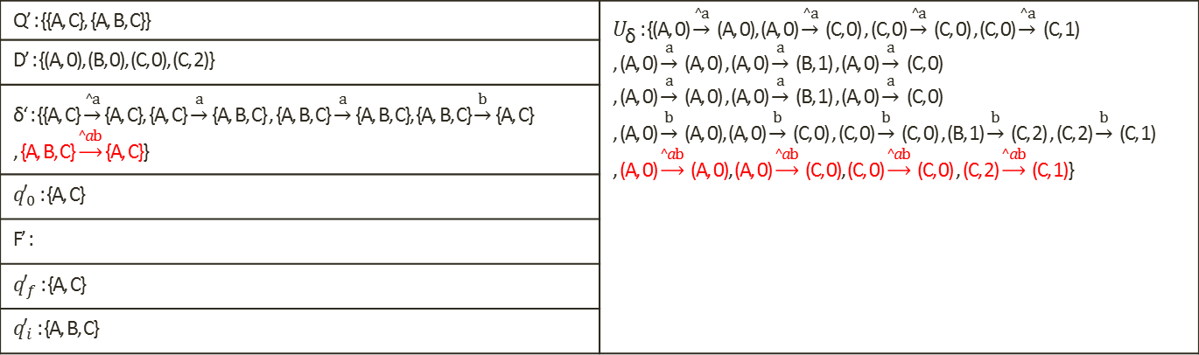
Build XFAs from Regex (Cont.)
Compile to XFA
  Alg. 2 : determinizing transitions for NXFAs
Q’ : {{A, C}, {A, B, C}} | $U_{\text{δ}}$ : {(A, 0) $\underset{→}{^a}$ (A, 0), (A, 0) $\underset{→}{^a}$ (C, 0) , (C, 0) $\underset{→}{^a}$ (C, 0) , (C, 0) $\underset{→}{^a}$ (C, 1) , (A, 0) $\underset{→}{a}$ (A, 0) , (A, 0) $\underset{→}{a}$ (B, 1) , (A, 0) $\underset{→}{a}$ (C, 0) , (A, 0) $\underset{→}{a}$ (A, 0) , (A, 0) $\underset{→}{a}$ (B, 1) , (A, 0) $\underset{→}{a}$ (C, 0) , (A, 0) $\underset{→}{b}$ (A, 0), (A, 0) $\underset{→}{b}$ (C, 0) , (C, 0) $\underset{→}{b}$ (C, 0) , (B, 1) $\underset{→}{b}$ (C, 2) , (C, 2) $\underset{→}{b}$ (C, 1) , (A, 0) $\underset{→}{^ab}$ (A, 0), (A, 0) $\underset{→}{^ab}$ (C, 0), (C, 0) $\underset{→}{^ab}$ (C, 0) , (C, 2) $\underset{→}{^ab}$ (C, 1)}
D’ : {(A, 0), (B, 0), (C, 0), (C, 2)}
δ‘ : {{A, C} $\underset{→}{^a}$ {A, C}, {A, C} $\underset{→}{a}$ {A, B, C} , {A, B, C} $\underset{→}{a}$ {A, B, C}, {A, B, C} $\underset{→}{b}$ {A, C} , {A, B, C} $\underset{→}{^ab}$ {A, C}}
${q′}_{0}$ : {A, C}
F’ :
${q′}_{f}$ : {A, C}
${q′}_{i}$ : {A, B, C}

Slide 25
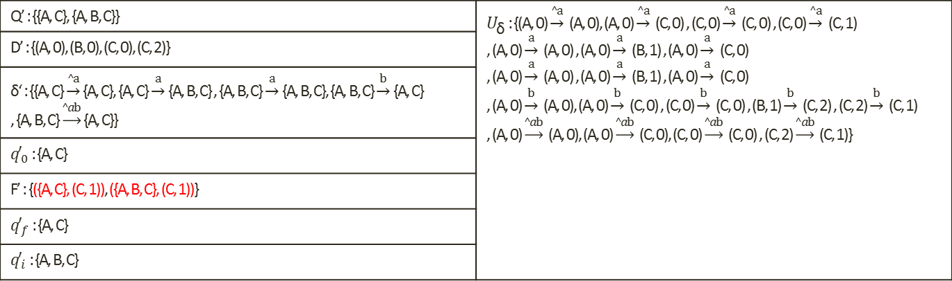
Build XFAs from Regex (Cont.)
Compile to XFA
  Alg. 2 : determinizing transitions for NXFAs
Q’ : {{A, C}, {A, B, C}} | $U_{\text{δ}}$ : {(A, 0) $\underset{→}{^a}$ (A, 0), (A, 0) $\underset{→}{^a}$ (C, 0) , (C, 0) $\underset{→}{^a}$ (C, 0) , (C, 0) $\underset{→}{^a}$ (C, 1) , (A, 0) $\underset{→}{a}$ (A, 0) , (A, 0) $\underset{→}{a}$ (B, 1) , (A, 0) $\underset{→}{a}$ (C, 0) , (A, 0) $\underset{→}{a}$ (A, 0) , (A, 0) $\underset{→}{a}$ (B, 1) , (A, 0) $\underset{→}{a}$ (C, 0) , (A, 0) $\underset{→}{b}$ (A, 0), (A, 0) $\underset{→}{b}$ (C, 0) , (C, 0) $\underset{→}{b}$ (C, 0) , (B, 1) $\underset{→}{b}$ (C, 2) , (C, 2) $\underset{→}{b}$ (C, 1) , (A, 0) $\underset{→}{^ab}$ (A, 0), (A, 0) $\underset{→}{^ab}$ (C, 0), (C, 0) $\underset{→}{^ab}$ (C, 0) , (C, 2) $\underset{→}{^ab}$ (C, 1)}
D’ : {(A, 0), (B, 0), (C, 0), (C, 2)}
δ‘ : {{A, C} $\underset{→}{^a}$ {A, C}, {A, C} $\underset{→}{a}$ {A, B, C} , {A, B, C} $\underset{→}{a}$ {A, B, C}, {A, B, C} $\underset{→}{b}$ {A, C} , {A, B, C} $\underset{→}{^ab}$ {A, C}}
${q′}_{0}$ : {A, C}
F’ : {({A, C}, (C, 1)), ({A, B, C}, (C, 1))}
${q′}_{f}$ : {A, C}
${q′}_{i}$ : {A, B, C}

Slide 26
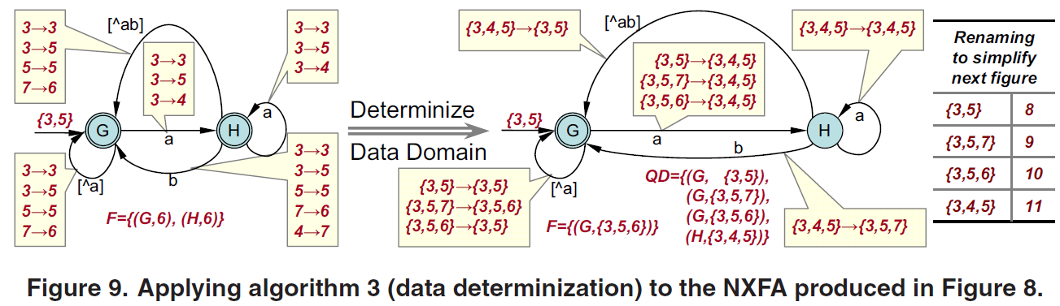
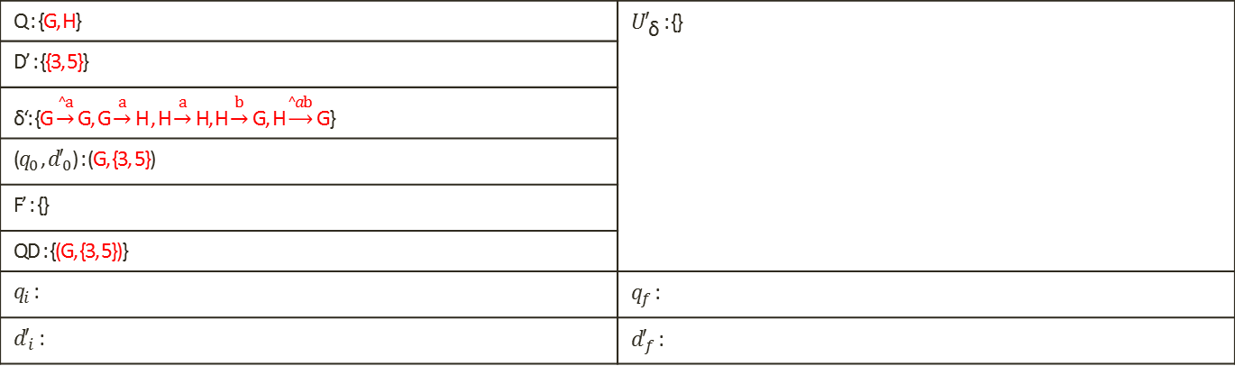
Build XFAs from Regex (Cont.)
Compile to XFA
  Alg. 3 : data determinization for NXFAs
Q : {G, H} | ${U′}_{\text{δ}}$ : {}
D’ : {{3, 5}}
δ‘: {G $\underset{→}{^a}$ G, G $\underset{→}{a}$ H , H $\underset{→}{a}$ H, H $\underset{→}{b}$ G, H $\underset{→}{^ab}$ G}
($q_{0}$ , ${d′}_{0}$) : (G, {3, 5})
F’ : {}
QD : {(G, {3, 5})}
$q_{i}$ : | $q_{f}$ :
${d′}_{i}$ : | ${d′}_{f}$ :

Slide 27
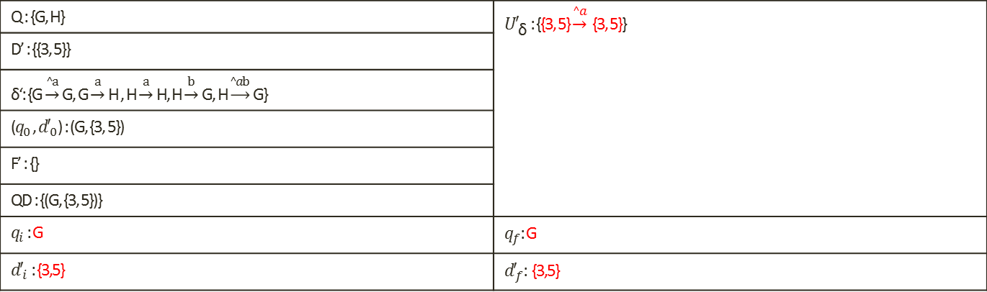
Build XFAs from Regex (Cont.)
Compile to XFA
  Alg. 3 : data determinization for NXFAs
Q : {G, H} | ${U′}_{\text{δ}}$ : {{3, 5} $\underset{→}{^a}$ {3, 5}}
D’ : {{3, 5}}
δ‘: {G $\underset{→}{^a}$ G, G $\underset{→}{a}$ H , H $\underset{→}{a}$ H, H $\underset{→}{b}$ G, H $\underset{→}{^ab}$ G}
($q_{0}$ , ${d′}_{0}$) : (G, {3, 5})
F’ : {}
QD : {(G, {3, 5})}
$q_{i}$ : G | $q_{f}$: G
${d′}_{i}$ : {3,5} | ${d′}_{f}$: {3,5}

Slide 28
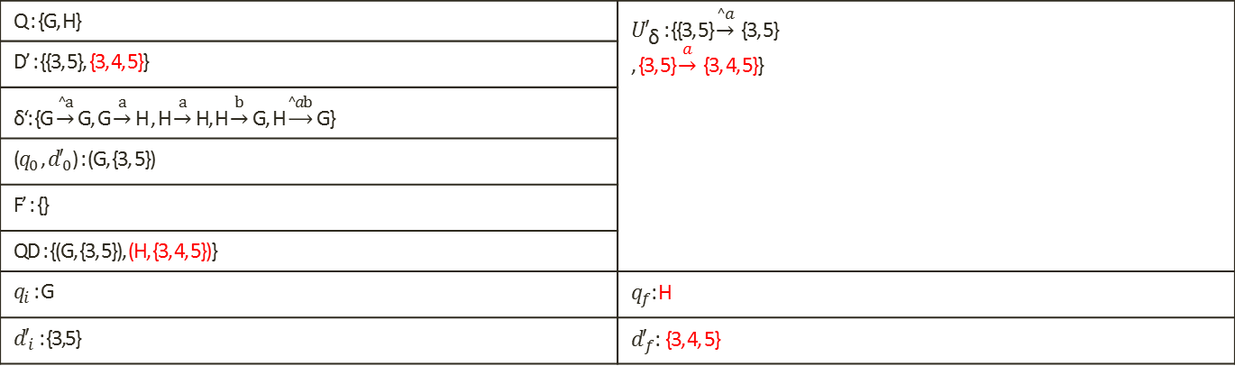
Build XFAs from Regex (Cont.)
Compile to XFA
  Alg. 3 : data determinization for NXFAs
Q : {G, H} | ${U′}_{\text{δ}}$ : {{3, 5} $\underset{→}{^a}$ {3, 5} , {3, 5} $\underset{→}{a}$ {3, 4, 5}}
D’ : {{3, 5}, {3, 4, 5}}
δ‘: {G $\underset{→}{^a}$ G, G $\underset{→}{a}$ H , H $\underset{→}{a}$ H, H $\underset{→}{b}$ G, H $\underset{→}{^ab}$ G}
($q_{0}$ , ${d′}_{0}$) : (G, {3, 5})
F’ : {}
QD : {(G, {3, 5}), (H, {3, 4, 5})}
$q_{i}$ : G | $q_{f}$: H
${d′}_{i}$ : {3,5} | ${d′}_{f}$: {3, 4, 5}

Slide 29
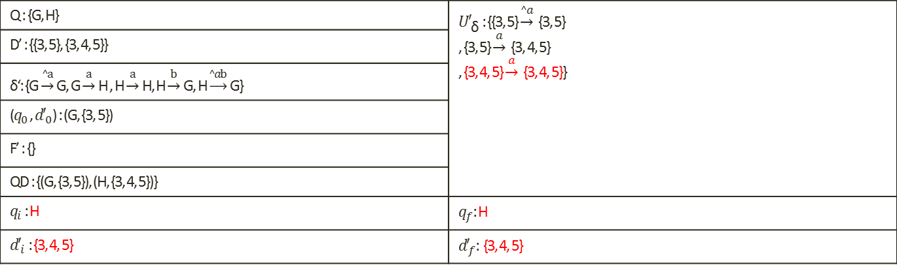
Build XFAs from Regex (Cont.)
Compile to XFA
  Alg. 3 : data determinization for NXFAs
Q : {G, H} | ${U′}_{\text{δ}}$ : {{3, 5} $\underset{→}{^a}$ {3, 5} , {3, 5} $\underset{→}{a}$ {3, 4, 5} , {3, 4, 5} $\underset{→}{a}$ {3, 4, 5}}
D’ : {{3, 5}, {3, 4, 5}}
δ‘: {G $\underset{→}{^a}$ G, G $\underset{→}{a}$ H , H $\underset{→}{a}$ H, H $\underset{→}{b}$ G, H $\underset{→}{^ab}$ G}
($q_{0}$ , ${d′}_{0}$) : (G, {3, 5})
F’ : {}
QD : {(G, {3, 5}), (H, {3, 4, 5})}
$q_{i}$ : H | $q_{f}$: H
${d′}_{i}$ : {3, 4, 5} | ${d′}_{f}$: {3, 4, 5}

Slide 30
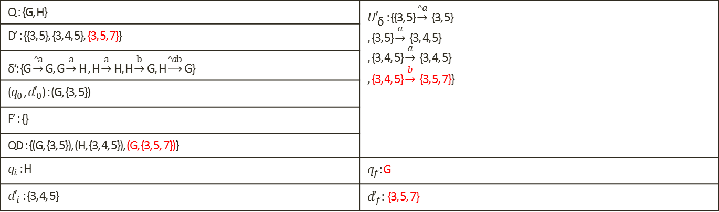
Build XFAs from Regex (Cont.)
Compile to XFA
  Alg. 3 : data determinization for NXFAs
Q : {G, H} | ${U′}_{\text{δ}}$ : {{3, 5} $\underset{→}{^a}$ {3, 5} , {3, 5} $\underset{→}{a}$ {3, 4, 5} , {3, 4, 5} $\underset{→}{a}$ {3, 4, 5} , {3, 4, 5} $\underset{→}{b}$ {3, 5, 7}}
D’ : {{3, 5}, {3, 4, 5}, {3, 5, 7}}
δ‘: {G $\underset{→}{^a}$ G, G $\underset{→}{a}$ H , H $\underset{→}{a}$ H, H $\underset{→}{b}$ G, H $\underset{→}{^ab}$ G}
($q_{0}$ , ${d′}_{0}$) : (G, {3, 5})
F’ : {}
QD : {(G, {3, 5}), (H, {3, 4, 5}), (G, {3, 5, 7})}
$q_{i}$ : H | $q_{f}$: G
${d′}_{i}$ : {3, 4, 5} | ${d′}_{f}$: {3, 5, 7}

Slide 31
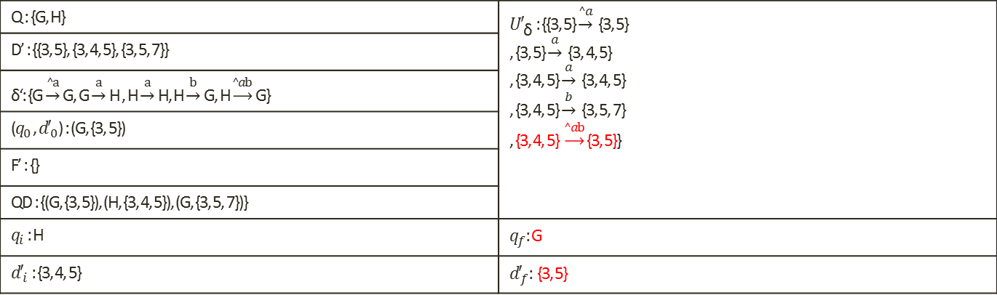
Build XFAs from Regex (Cont.)
Compile to XFA
  Alg. 3 : data determinization for NXFAs
Q : {G, H} | ${U′}_{\text{δ}}$ : {{3, 5} $\underset{→}{^a}$ {3, 5} , {3, 5} $\underset{→}{a}$ {3, 4, 5} , {3, 4, 5} $\underset{→}{a}$ {3, 4, 5} , {3, 4, 5} $\underset{→}{b}$ {3, 5, 7} , {3, 4, 5} $\underset{→}{^ab}$ {3, 5}}
D’ : {{3, 5}, {3, 4, 5}, {3, 5, 7}}
δ‘: {G $\underset{→}{^a}$ G, G $\underset{→}{a}$ H , H $\underset{→}{a}$ H, H $\underset{→}{b}$ G, H $\underset{→}{^ab}$ G}
($q_{0}$ , ${d′}_{0}$) : (G, {3, 5})
F’ : {}
QD : {(G, {3, 5}), (H, {3, 4, 5}), (G, {3, 5, 7})}
$q_{i}$ : H | $q_{f}$: G
${d′}_{i}$ : {3, 4, 5} | ${d′}_{f}$: {3, 5}

Slide 32
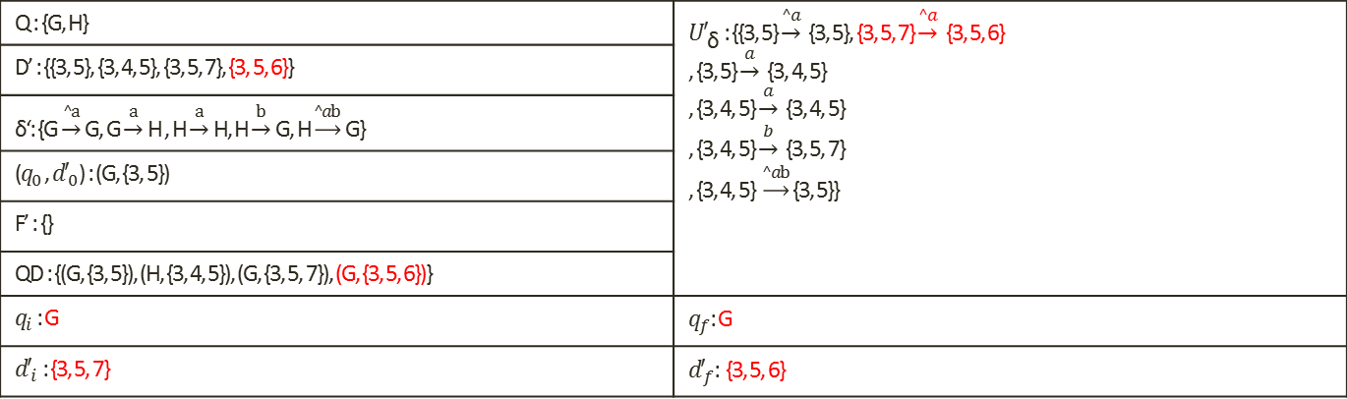
Build XFAs from Regex (Cont.)
Compile to XFA
  Alg. 3 : data determinization for NXFAs
Q : {G, H} | ${U′}_{\text{δ}}$ : {{3, 5} $\underset{→}{^a}$ {3, 5}, {3, 5, 7} $\underset{→}{^a}$ {3, 5, 6} , {3, 5} $\underset{→}{a}$ {3, 4, 5} , {3, 4, 5} $\underset{→}{a}$ {3, 4, 5} , {3, 4, 5} $\underset{→}{b}$ {3, 5, 7} , {3, 4, 5} $\underset{→}{^ab}$ {3, 5}}
D’ : {{3, 5}, {3, 4, 5}, {3, 5, 7}, {3, 5, 6}}
δ‘: {G $\underset{→}{^a}$ G, G $\underset{→}{a}$ H , H $\underset{→}{a}$ H, H $\underset{→}{b}$ G, H $\underset{→}{^ab}$ G}
($q_{0}$ , ${d′}_{0}$) : (G, {3, 5})
F’ : {}
QD : {(G, {3, 5}), (H, {3, 4, 5}), (G, {3, 5, 7}), (G, {3, 5, 6})}
$q_{i}$ : G | $q_{f}$: G
${d′}_{i}$ : {3, 5, 7} | ${d′}_{f}$: {3, 5, 6}

Slide 33
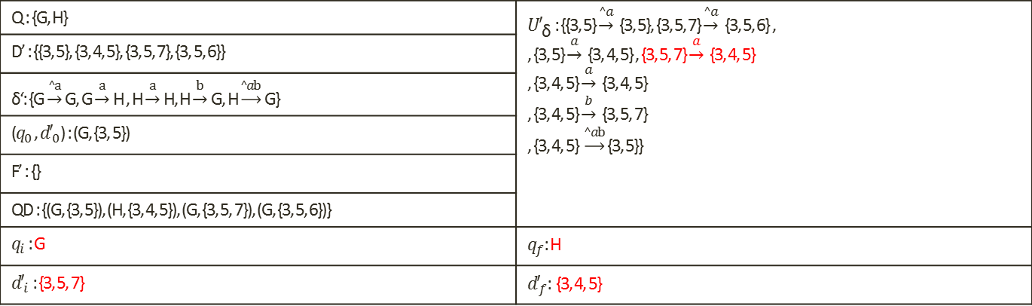
Build XFAs from Regex (Cont.)
Compile to XFA
  Alg. 3 : data determinization for NXFAs
Q : {G, H} | ${U′}_{\text{δ}}$ : {{3, 5} $\underset{→}{^a}$ {3, 5}, {3, 5, 7} $\underset{→}{^a}$ {3, 5, 6} , , {3, 5} $\underset{→}{a}$ {3, 4, 5} , {3, 5, 7} $\underset{→}{a}$ {3, 4, 5} , {3, 4, 5} $\underset{→}{a}$ {3, 4, 5} , {3, 4, 5} $\underset{→}{b}$ {3, 5, 7} , {3, 4, 5} $\underset{→}{^ab}$ {3, 5}}
D’ : {{3, 5}, {3, 4, 5}, {3, 5, 7}, {3, 5, 6}}
δ‘: {G $\underset{→}{^a}$ G, G $\underset{→}{a}$ H , H $\underset{→}{a}$ H, H $\underset{→}{b}$ G, H $\underset{→}{^ab}$ G}
($q_{0}$ , ${d′}_{0}$) : (G, {3, 5})
F’ : {}
QD : {(G, {3, 5}), (H, {3, 4, 5}), (G, {3, 5, 7}), (G, {3, 5, 6})}
$q_{i}$ : G | $q_{f}$: H
${d′}_{i}$ : {3, 5, 7} | ${d′}_{f}$: {3, 4, 5}

Slide 34
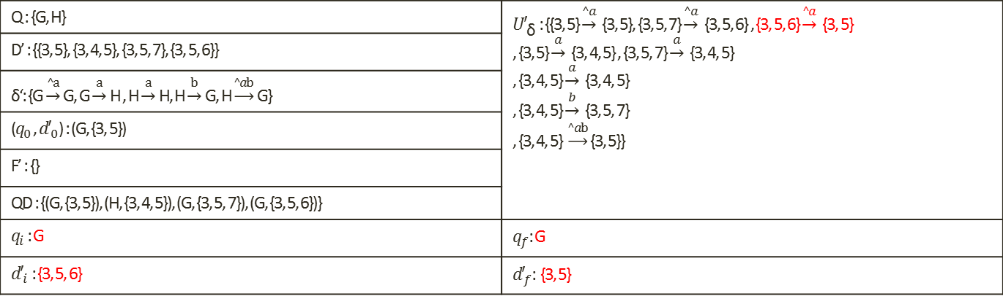
Build XFAs from Regex (Cont.)
Compile to XFA
  Alg. 3 : data determinization for NXFAs
Q : {G, H} | ${U′}_{\text{δ}}$ : {{3, 5} $\underset{→}{^a}$ {3, 5}, {3, 5, 7} $\underset{→}{^a}$ {3, 5, 6} , {3, 5, 6} $\underset{→}{^a}$ {3, 5} , {3, 5} $\underset{→}{a}$ {3, 4, 5} , {3, 5, 7} $\underset{→}{a}$ {3, 4, 5} , {3, 4, 5} $\underset{→}{a}$ {3, 4, 5} , {3, 4, 5} $\underset{→}{b}$ {3, 5, 7} , {3, 4, 5} $\underset{→}{^ab}$ {3, 5}}
D’ : {{3, 5}, {3, 4, 5}, {3, 5, 7}, {3, 5, 6}}
δ‘: {G $\underset{→}{^a}$ G, G $\underset{→}{a}$ H , H $\underset{→}{a}$ H, H $\underset{→}{b}$ G, H $\underset{→}{^ab}$ G}
($q_{0}$ , ${d′}_{0}$) : (G, {3, 5})
F’ : {}
QD : {(G, {3, 5}), (H, {3, 4, 5}), (G, {3, 5, 7}), (G, {3, 5, 6})}
$q_{i}$ : G | $q_{f}$: G
${d′}_{i}$ : {3, 5, 6} | ${d′}_{f}$: {3, 5}

Slide 35
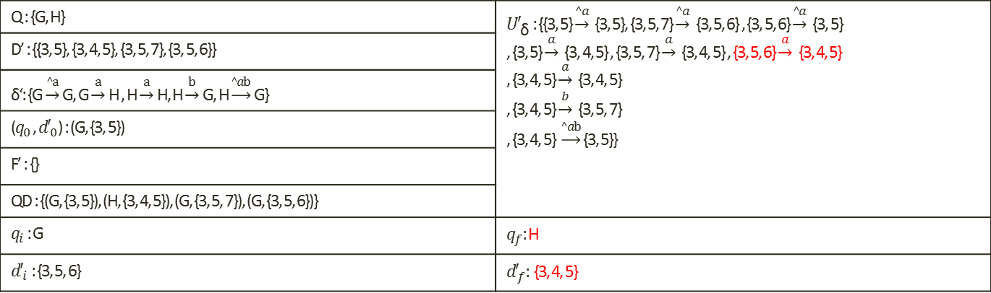
Build XFAs from Regex (Cont.)
Compile to XFA
  Alg. 3 : data determinization for NXFAs
Q : {G, H} | ${U′}_{\text{δ}}$ : {{3, 5} $\underset{→}{^a}$ {3, 5}, {3, 5, 7} $\underset{→}{^a}$ {3, 5, 6} , {3, 5, 6} $\underset{→}{^a}$ {3, 5} , {3, 5} $\underset{→}{a}$ {3, 4, 5} , {3, 5, 7} $\underset{→}{a}$ {3, 4, 5} , {3, 5, 6} $\underset{→}{a}$ {3, 4, 5} , {3, 4, 5} $\underset{→}{a}$ {3, 4, 5} , {3, 4, 5} $\underset{→}{b}$ {3, 5, 7} , {3, 4, 5} $\underset{→}{^ab}$ {3, 5}}
D’ : {{3, 5}, {3, 4, 5}, {3, 5, 7}, {3, 5, 6}}
δ‘: {G $\underset{→}{^a}$ G, G $\underset{→}{a}$ H , H $\underset{→}{a}$ H, H $\underset{→}{b}$ G, H $\underset{→}{^ab}$ G}
($q_{0}$ , ${d′}_{0}$) : (G, {3, 5})
F’ : {}
QD : {(G, {3, 5}), (H, {3, 4, 5}), (G, {3, 5, 7}), (G, {3, 5, 6})}
$q_{i}$ : G | $q_{f}$: H
${d′}_{i}$ : {3, 5, 6} | ${d′}_{f}$: {3, 4, 5}

Slide 36
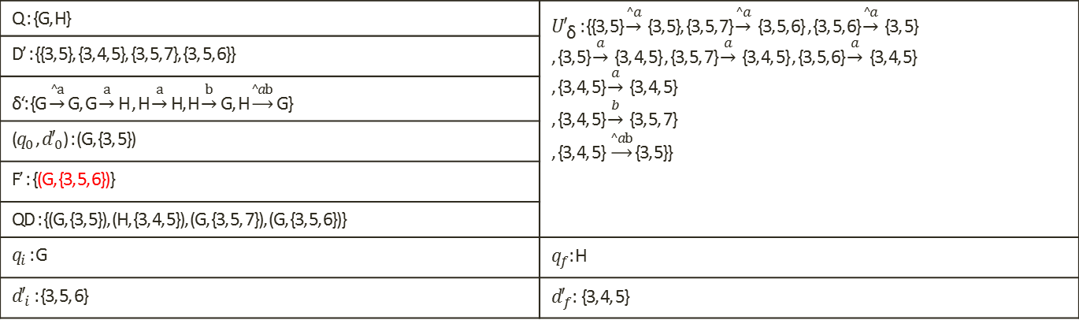
Build XFAs from Regex (Cont.)
Compile to XFA
  Alg. 3 : data determinization for NXFAs
Q : {G, H} | ${U′}_{\text{δ}}$ : {{3, 5} $\underset{→}{^a}$ {3, 5}, {3, 5, 7} $\underset{→}{^a}$ {3, 5, 6} , {3, 5, 6} $\underset{→}{^a}$ {3, 5} , {3, 5} $\underset{→}{a}$ {3, 4, 5} , {3, 5, 7} $\underset{→}{a}$ {3, 4, 5} , {3, 5, 6} $\underset{→}{a}$ {3, 4, 5} , {3, 4, 5} $\underset{→}{a}$ {3, 4, 5} , {3, 4, 5} $\underset{→}{b}$ {3, 5, 7} , {3, 4, 5} $\underset{→}{^ab}$ {3, 5}}
D’ : {{3, 5}, {3, 4, 5}, {3, 5, 7}, {3, 5, 6}}
δ‘: {G $\underset{→}{^a}$ G, G $\underset{→}{a}$ H , H $\underset{→}{a}$ H, H $\underset{→}{b}$ G, H $\underset{→}{^ab}$ G}
($q_{0}$ , ${d′}_{0}$) : (G, {3, 5})
F’ : {(G, {3, 5, 6})}
QD : {(G, {3, 5}), (H, {3, 4, 5}), (G, {3, 5, 7}), (G, {3, 5, 6})}
$q_{i}$ : G | $q_{f}$: H
${d′}_{i}$ : {3, 5, 6} | ${d′}_{f}$: {3, 4, 5}

Slide 37
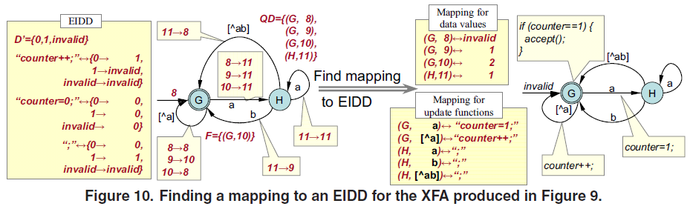
Build XFAs from Regex (Cont.)
Compile to XFA
  Finding efficient implementations

Slide 38
Experimental Results
1450 Regular expressions extracted from Snort HTTP
Characteristics of combined XFA:􀂄
  41,994 total states => 42 MB
  195 bits (~25 bytes) of aux memory
  Instruction memory: 3.5 MB

Slide 39
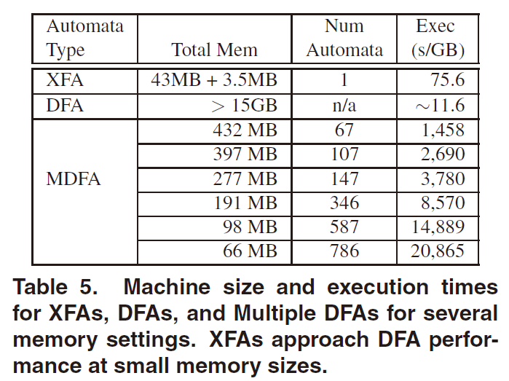
Experimental Results (Cont.)

Slide 40
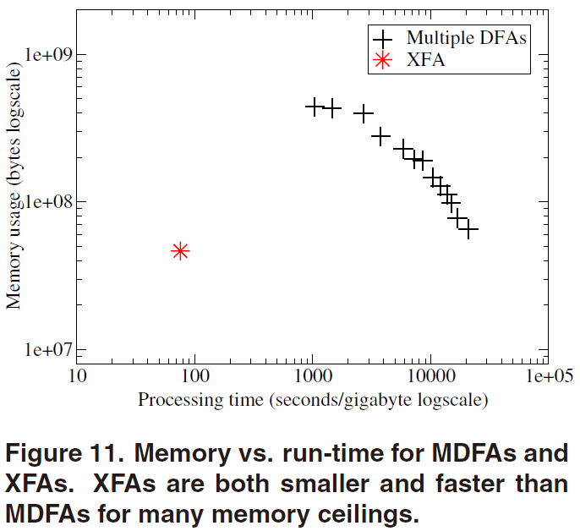
Experimental Results (Cont.)

Slide 41
Conclusion
DFAs for regular expressions often blow up when combined
  XFA = DFAs+ auxiliary variables􀂄
    Changes shape of automata
    Tames state space explosion
Result: compared to other feasible approaches, reduce both time and space

